Slide 1
AngularJS + Asp.Net Web Api + Signalr：前後端整合篇
開發技巧實戰系列(3/6) - Web 前後端整合
講師: 郭二文 (erhwenkuo@gmail.com)
Notes:
開發技巧實戰
1. AngularJS入門篇
2. AngularJS + HighChart：完美網頁圖表整合篇
3. AngularJS + Asp.Net WebApi 2：前後端整合篇
4. AngularJS + Asp.Net WebApi 2+Entity Framework 6 (ORM)：前後端整合篇
5. AngularJS + Asp.Net WebApi 2+Entity Framework 6 (ORM) + Redis (Nosql)：前後端整合篇
6. AngularJS + Asp.Net WebApi 2+Entity Framework 6 (ORM) + Redis (Nosql) + Elasticsearch (全文檢索)：前後端整合篇

Slide 2
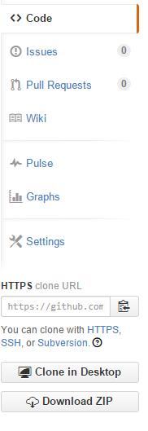
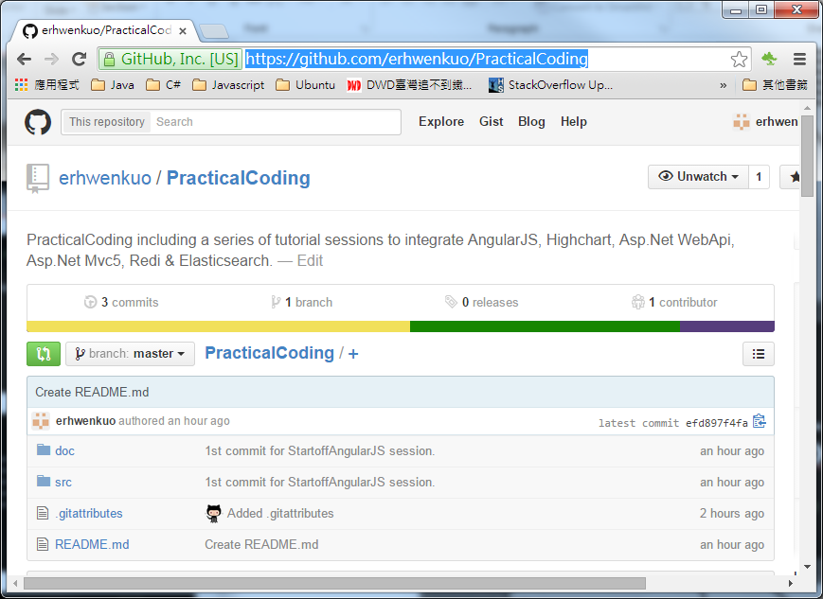

Document, Source code & Training Video (3/6)
https://github.com/erhwenkuo/PracticalCoding

Slide 3


Previous Training Session Document, Source code & Training Video (2/6)
https://www.youtube.com/watch?v=EVvC4YGXfDI
http://www.slideshare.net/erhwenkuo/02-integrate-highchart
Notes:
本章節的內容會延續前一個Session的知識與內容, 如果對前一章節不熟悉的話, 可以在Yoube或Slideshare找到文件與教學錄影

Slide 4
Agenda
Part_1
REST (Representational State Transfer)
Developing & Testing of ASP.Net Web API2
Highchart , AngularJS & Web API2 Integration
Part_2
Developing ASP.Net SignalR2
Highchart , AngularJS ,Web API2 + SignalR2 Integration
Notes:
The agenda is…
We’re going to start off with some of the key features AngularJS offers and I’ll kind of introduce the challenge with writing SPAs from scratch.
Anyone who knows me knows I do not recommend writing them from scratch. I just think that in the long term it is, when it comes to maintenance, a nightmare.
There’s too many scripts involved and I’m worried about version dependencies and scripts changing and things breaking.
So we’re going to talk about that and how Angular addresses it.
Then we’re going to get started with some of the framework fundamental features that Angular provides.
Then I’ll go into some of those key features that you’ve really got to start off with, kind of the A-B-Cs of Angular if you will, so Directives, Filters and two-way Data Binding which is just awesome.
I’m a big fan of some of the other scripts out there – like KnockoutJS as an example - but you’re going to see that Angular is a true framework. It’s not just a library that does maybe one or two things: it actually can do a LOT of different things.
Once we get through the Directives, Filters and Data Binding we’re going to talk about Views, Controllers and Scope.
And then we’ll wrap up with Modules, and we’ll talk about how all this other stuff fits into modules, and then we’ll get into some SPA concepts like Routes and even Factories for sharing data and using data.

Slide 5
REST (Representational State Transfer)

Slide 6
What is REST?
REST stands for Representational State Transfer
REST is an architecture style for designing networked applications
RESTful applications use HTTP requests to post data (create and/or update), read data (e.g., make queries), and delete data
REST is a lightweight alternative to mechanisms like RPC (Remote Procedure Calls) and Web Services (SOAP, WSDL, et al.)
Notes:
何謂 REST?
REST是REpresentational State Transfer的縮寫，從這個縮寫實在很難看出這東西是什麼，然而他是一個設計理念，而這個概念也漸漸變成目前Web設計的主流。REST把所有WEB上的東西都以一個資源(Resource)去看待，並且所有資源都會有一個URI(Uniform Resource Identifier)，這個概念就是們常見的網址，由於Web底層用的HTTP本身就是這樣的設計，所以這個概念應該大部分的人都知道。

Slide 7
Advantages Of REST
Separates server implementation from the client’s perception of resources (use standard HTTP GET/POST/PUT/DELETE verbs)
Scales well to large numbers of clients
Enable transfer of data in streams of unlimited size and type
Support intermediaries (proxies and gateways) as data transformation and caching components

Slide 8
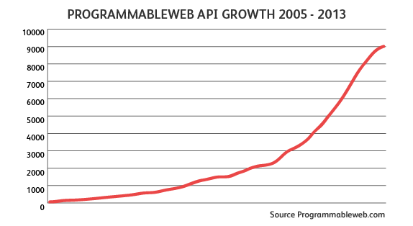
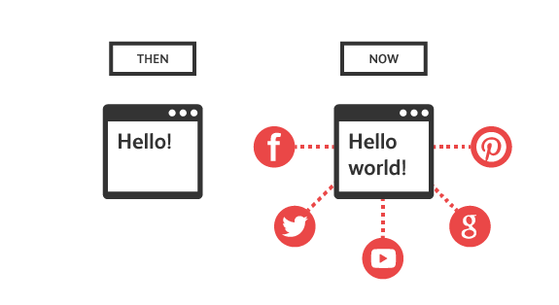
The Golden Age of APIs
On today's World Wide Web everything is interconnected, and every user is both a consumer and a creator
Any website/web application can be an API provider, an API consumer, and an end user, all in one
The number of private and public APIs has been growing exponentially

Slide 9
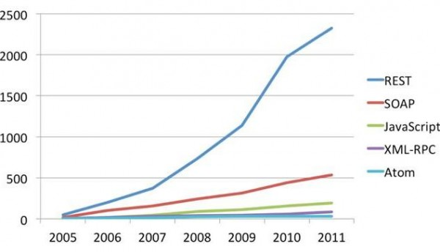
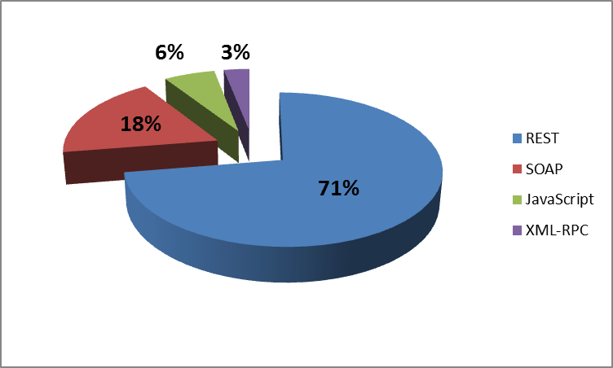
Protocol Usage by Web API
REST web api taking over SOAP web services
Google deprecated all SOAP web services and converted to REST web apis

Slide 10

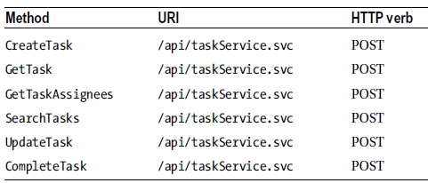
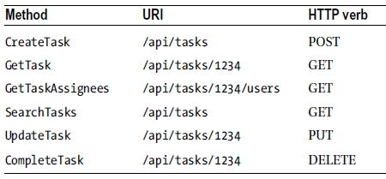
SOAP v.s. REST

Slide 11
Developing & Testing of ASP.Net Web API2

Slide 12
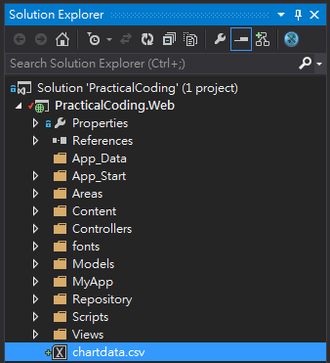
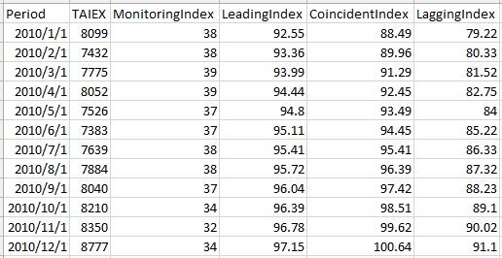
Develop WEP API to service Chartdata
In this portion, an Asp.Net Web API will be developed to server our Chartdata
Data Definition:
Period: 期間 (yyyy-MM-dd)
TAIEX: 台股加權指數
MonitoringIndex: 景氣對策信號
LeadingIndex: 景氣領先指標
CoincidentIndex: 景氣同時指標
LaggingIndex: 景氣落後指標
Data File Path
PracticalCoding\web\chartdata.csv
Notes:
axes.

Slide 13
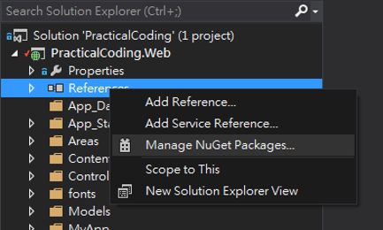

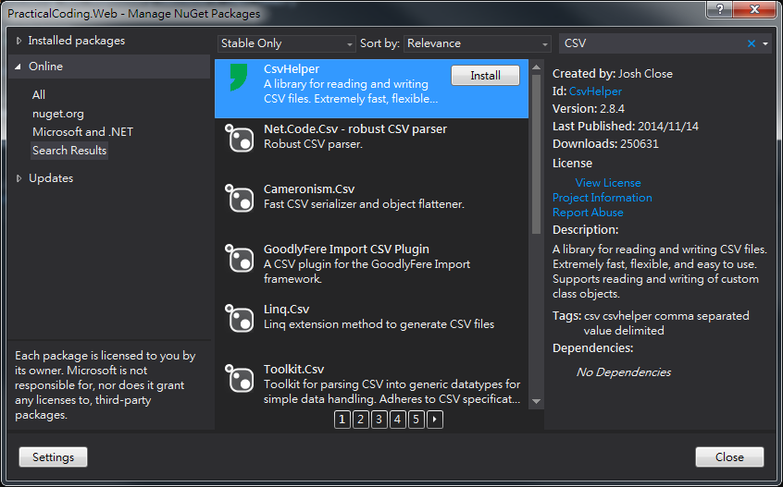

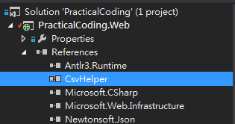

Install CsvHelper 3rd Party Library
Use NuGet to search CsvHelper
Click “Install”

Slide 14
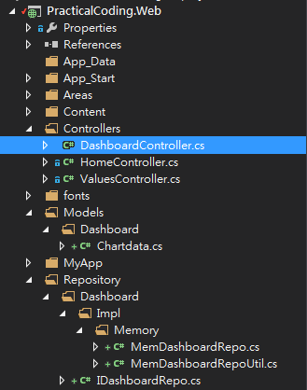
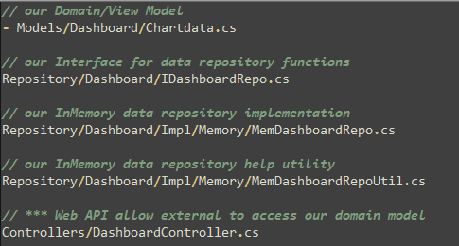
Web API demonstration Implementation
To create our Web API demonstration, below 5 files need to be created:
Notes:
There’s our HTML file. We will use Bootstrap to help with our styling. Notice that we also load up ui-router in addition to loading Angular. UI Router is separate from the Angular core, just like ngRoute is separate.
When creating a link with UI-Router, you will useui-sref. The href will be generated from this and you want this to point to a certain state of your application. These are created in your app.js.
We also use <div ui-view></div> instead of ngRoute’s <div ng-view></div>.

Slide 15
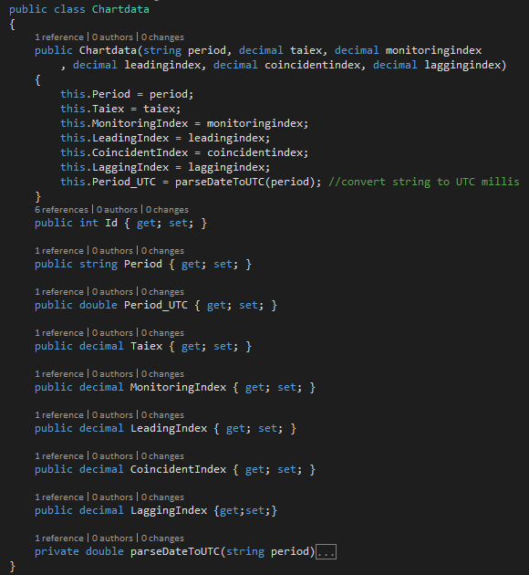
Chartdata.cs (1/5)
Create a POCO class to represent our Chartdata
Chartdata contain a private method “parseDateToUTC” is used to convert date string (yyyy/MM/dd) to milliseconds start from 1970/1/1 00:00:00

Slide 16
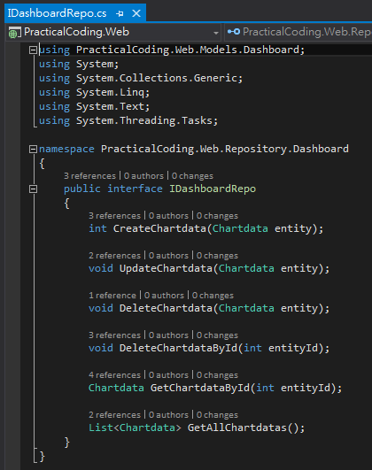
IDashboardRepo.cs (2/5)
Interface for most basic data repository functions (CRUD)
C (Create) → CreateChartdata
U (Update) → UpdateChartdata
D (Delete) → DeleteChartdataById
D (Delete) → DeleteChartdata
R (Query) → GetAllChartdatas
R (Query) → GetChartdataById
Why use interface?
It’s a good design/coding practice
Allow different implementation
Allow dynamic replacement

Slide 17
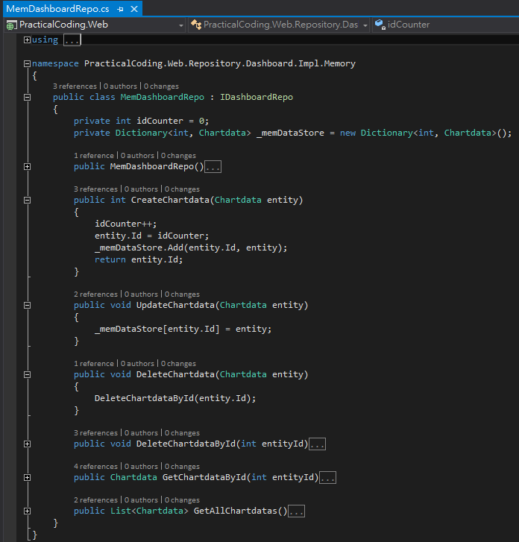
MemDashboardRepo.cs (3/5)
IDashboard Interface implementation using in-memory C# Dictionary object to hold our demonstration data
Notes: To simplify demonstration, there is no code to prevent multi-concurrent access/modification handling

Slide 18
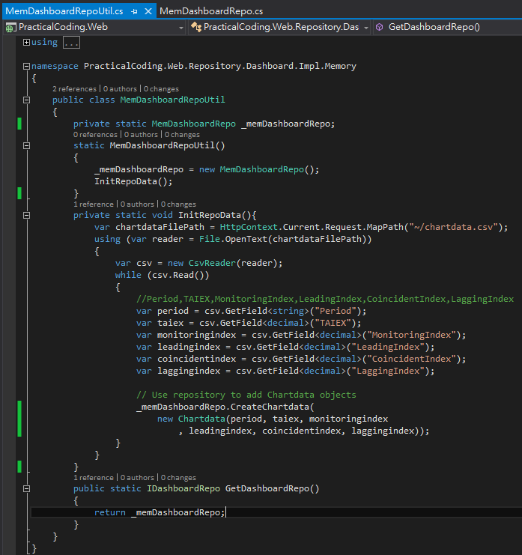
MemDashboardRepoUtil.cs (4/5)
A simple helper static class to keep one “MemDashboardRepo” object instance in memory
Load “chartdata.csv” data into “MemDashboardRepo” data store as initialization for demonstration
Why not use “Singleton” pattern
Just to simplify code and not confuse programmers who are not familiar with object oriented DESIGN PATTERNs

Slide 19
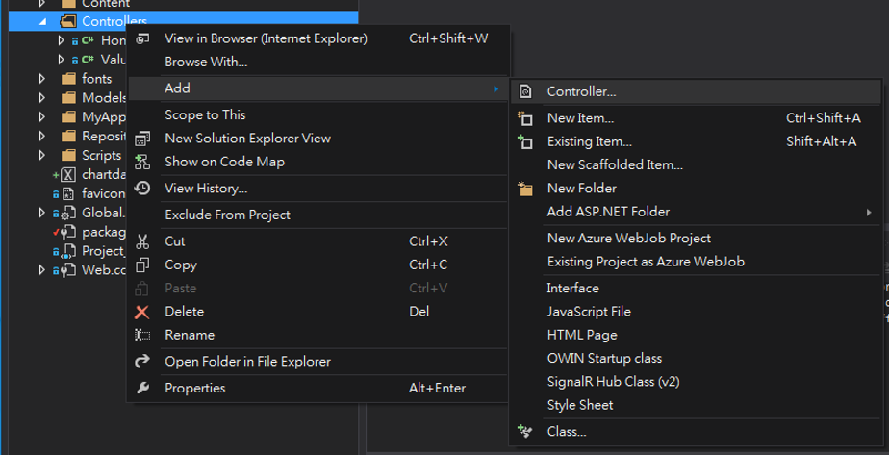
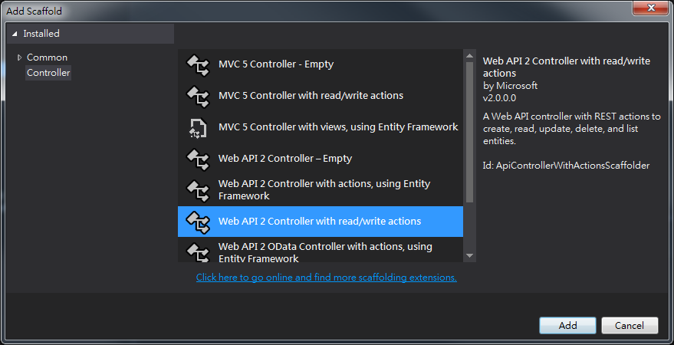
DashboardController.cs (5/5)
Choose “Controllers” folder
RighClick and choose below menu item
“Add” → “Controller…”
Choose “Web API2 Controller with read/write actions” template

Slide 20
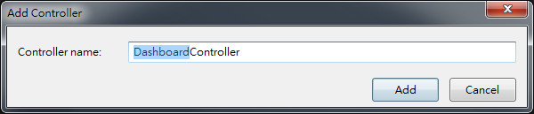
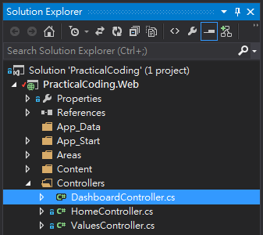
DashboardController.cs (5/5)
Change Controller name to “DashboardController”
A new class named “DashboardController.cs” should be created under “Controllers” folder
Notes:
There’s our HTML file. We will use Bootstrap to help with our styling. Notice that we also load up ui-router in addition to loading Angular. UI Router is separate from the Angular core, just like ngRoute is separate.
When creating a link with UI-Router, you will useui-sref. The href will be generated from this and you want this to point to a certain state of your application. These are created in your app.js.
We also use <div ui-view></div> instead of ngRoute’s <div ng-view></div>.

Slide 21
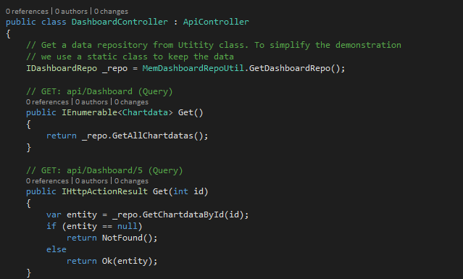
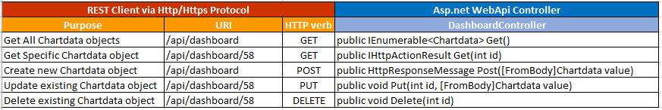
DashboardController.cs (5/5)
Notes:
There’s our HTML file. We will use Bootstrap to help with our styling. Notice that we also load up ui-router in addition to loading Angular. UI Router is separate from the Angular core, just like ngRoute is separate.
When creating a link with UI-Router, you will useui-sref. The href will be generated from this and you want this to point to a certain state of your application. These are created in your app.js.
We also use <div ui-view></div> instead of ngRoute’s <div ng-view></div>.

Slide 22
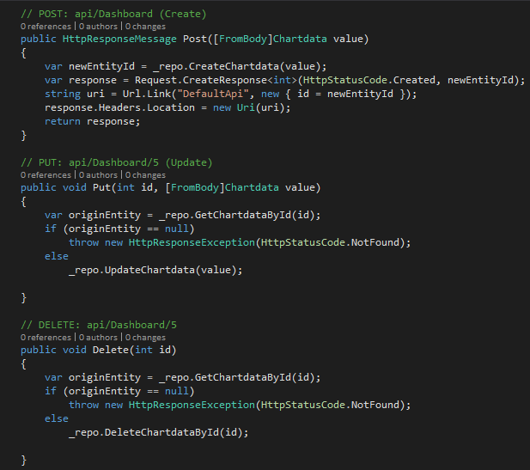
DashboardController.cs (5/5)
Notes:
There’s our HTML file. We will use Bootstrap to help with our styling. Notice that we also load up ui-router in addition to loading Angular. UI Router is separate from the Angular core, just like ngRoute is separate.
When creating a link with UI-Router, you will useui-sref. The href will be generated from this and you want this to point to a certain state of your application. These are created in your app.js.
We also use <div ui-view></div> instead of ngRoute’s <div ng-view></div>.

Slide 23
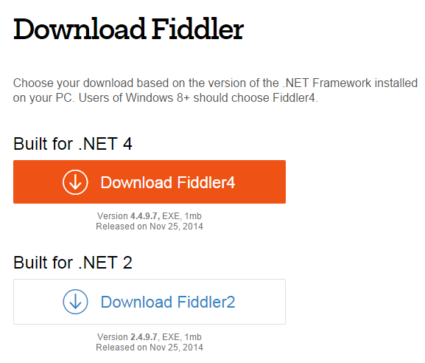
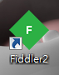
Testing ASP.Net Web API–GET, POST, PUT, DELETE using Fiddler2
What is “Fiddler2”
The free web debugging proxy for any browser, system or platform
Developed by “Telerick”
Where to get & install
Go to “Fiddler” download page “http://www.telerik.com/download/fiddler”
Click “Download Fiddler2” link
Execute “fiddler2set.exe”

Slide 24
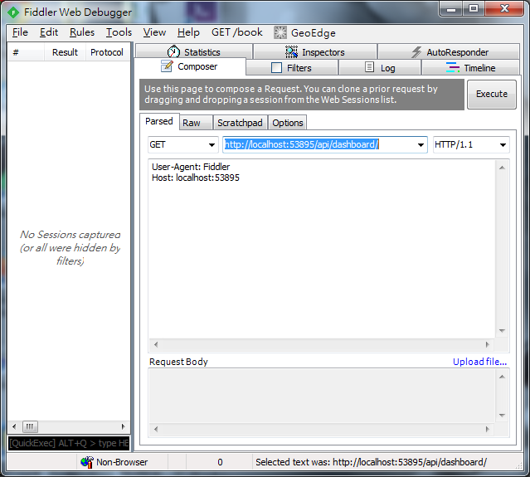
Testing ASP.Net Web API–GET
Demo
Hit “F5” to run “PracticalCoding.Web” project
Find the url and port, for example: “http://localhost:53895”
Click “Composer” Tab, Change method to “GET”, past our WebUrl with our web api path to Fiddler http://localhost:53895/api/dashboard/
Hit “Execute” button

Slide 25
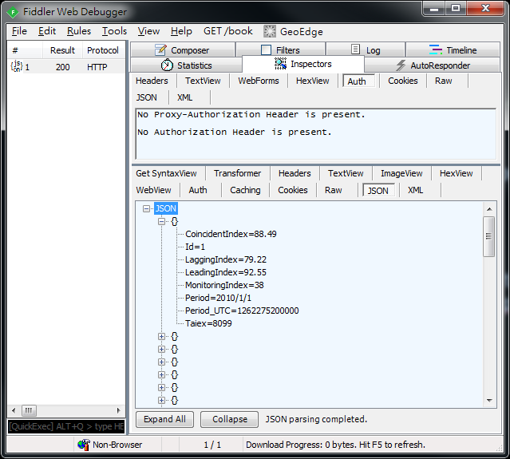
Testing ASP.Net Web API–GET Result
Demo
Http Status Code (200 – OK) in left panel
Click “JSON” Tab
A JSON object array contains 58 objects

Slide 26
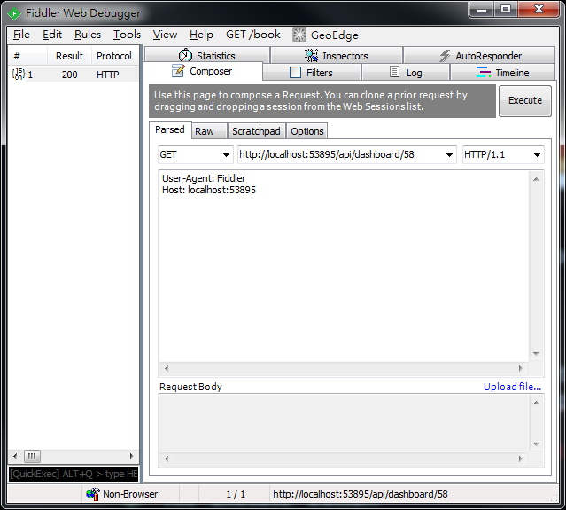
Testing ASP.Net Web API–GET
Demo
Hit “F5” to run “PracticalCoding.Web” project
Find the url and port, for example: “http://localhost:53895”
Click “Composer” Tab, Change method to “GET”, past our WebUrl with our web api path to Fiddler http://localhost:53895/api/dashboard/58
Hit “Execute” button

Slide 27
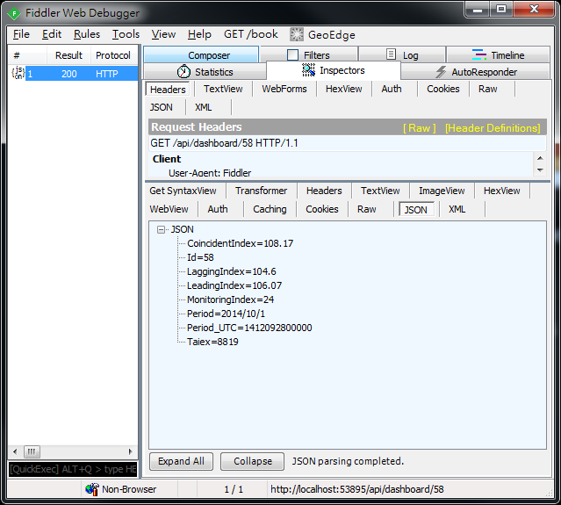
Testing ASP.Net Web API–GET Result
Demo
Click Http Status Code (200 – OK) in left panel
Click “JSON” Tab
A JSON object contains Chartdata object in JSON notation

Slide 28
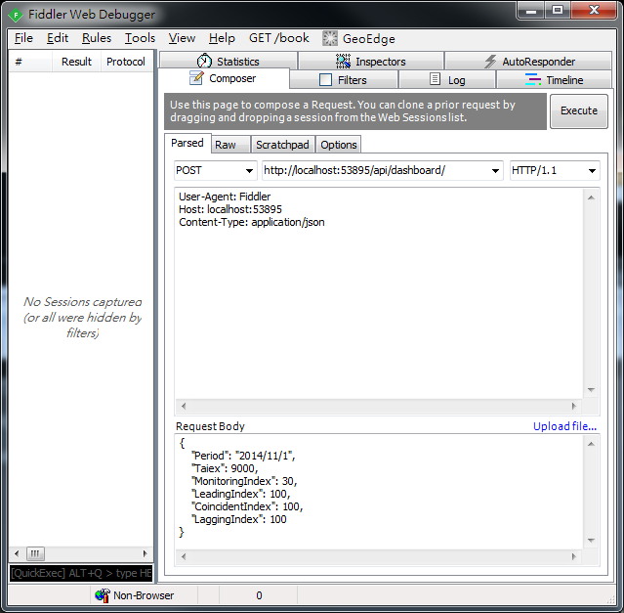
Testing ASP.Net Web API–POST
Demo
Click “Composer” Tab, Change method to “POST”, past our WebUrl with our web api path to Fiddler http://localhost:53895/api/dashboard/
Add “Content-Type: application/json” to indicates the content in the request body is JSON object
Hit “Execute” button

Slide 29
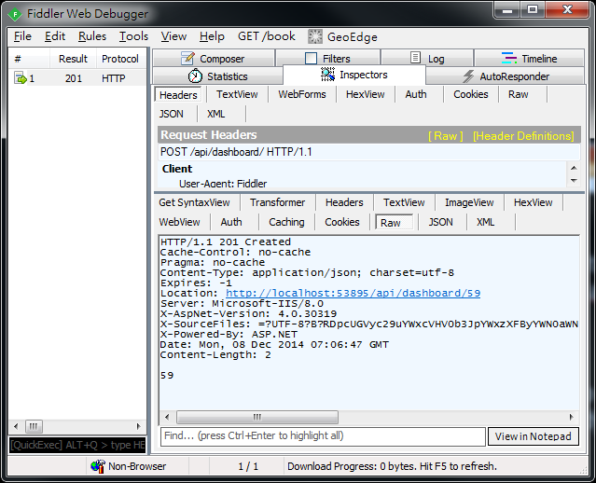
Testing ASP.Net Web API–POST
Demo
Click Http Status Code (201 – Created) in left panel
Click “Raw” Tab
“59” is the new Chartdata EntityId

Slide 30
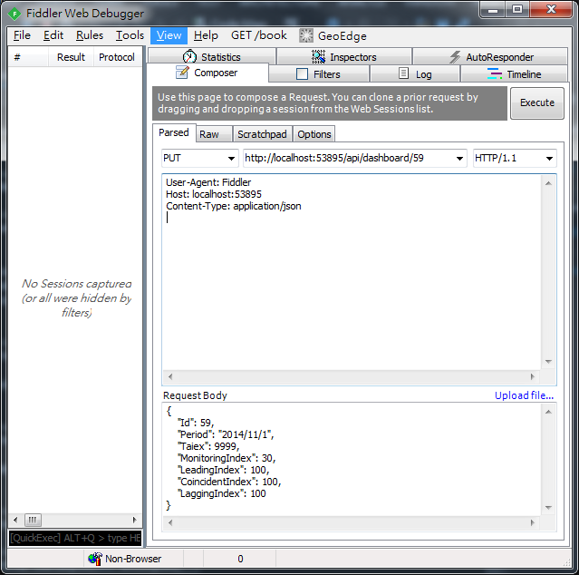
Testing ASP.Net Web API–PUT
Demo
Click “Composer” Tab, Change method to “PUT”, past our WebUrl with our web api path with EntityId to Fiddler http://localhost:53895/api/dashboard/59
Add “Content-Type: application/json” to indicates the content in the request body is JSON object
Put Entity Object in JSON style in “Request Body”
Hit “Execute” button

Slide 31
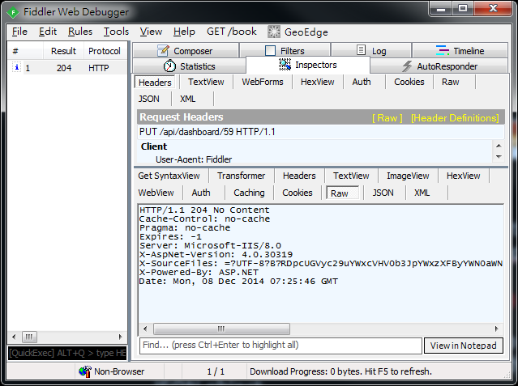
Testing ASP.Net Web API–PUT
Demo
Click Http Status Code (204 – No Content) in left panel

Slide 32
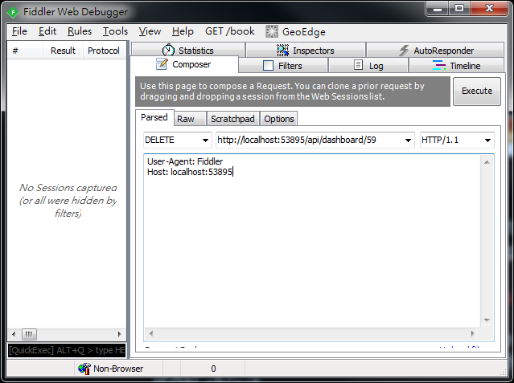
Testing ASP.Net Web API–DELETE
Demo
Click “Composer” Tab, Change method to “DELETE”, past our WebUrl with our web api path with EntityId to Fiddler http://localhost:53895/api/dashboard/59
Hit “Execute” button

Slide 33

Testing ASP.Net Web API–PUT
Demo
Click Http Status Code (204 – No Content) in left panel

Slide 34
Highchart , AngularJS & Web API2 Integration

Slide 35
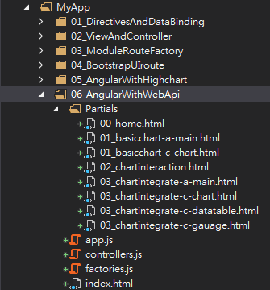
Setup SPA Folder
Copy “05_AngularWithHighchart” folder and paste as “06_AngularWithWebApi”

Slide 36
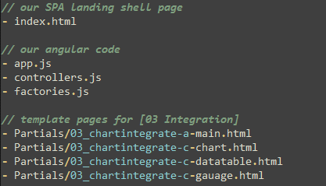
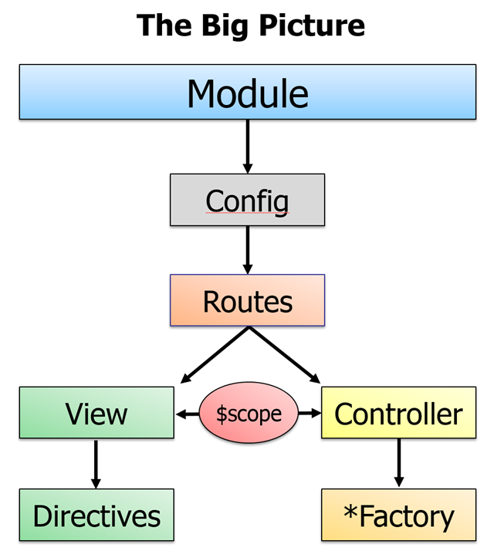
Integration with WebApi
The major code we need to change is “factories.js”
The key concepts (thinking in Angular) :
Encasuplate communication service with backend WebAPI via Factory module
Factory can easily be substituted or replaced if needed
“factories.js” contains code to demonstrate above points
The other code we need to change is “controllers.js”
Add more controller methods to support Create / Update & Delete operations
Notes:
axes.

Slide 37
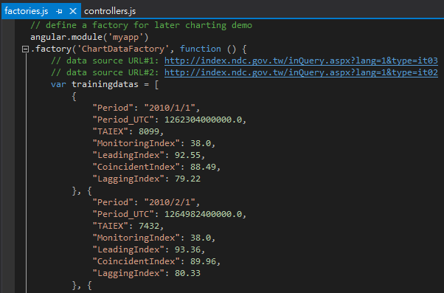
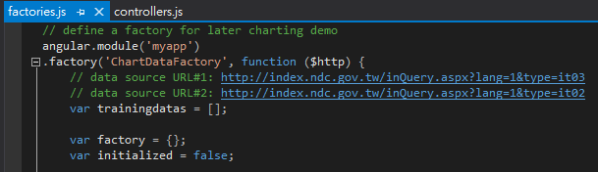
Integration with WebApi (factories.js)
Cleanup all static trainingdatas object array
Before
After
Notes:
axes.

Slide 38
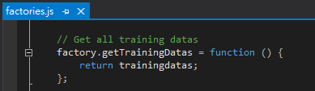
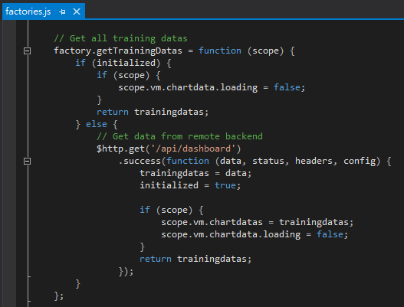
Integration with WebApi (factories.js)
Change “factory.getTrainingDatas” method to retrieve data from remote WebApi “/api/dashboard”
Before
After
Get the data via remote WebApi using angular $http service object
Get the data from local static variable
Notes:
axes.

Slide 39
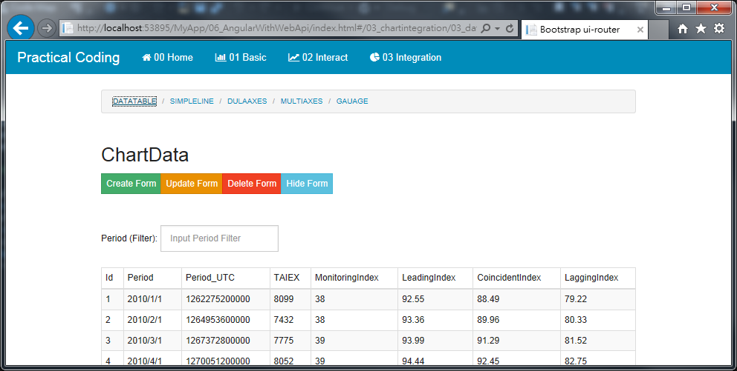
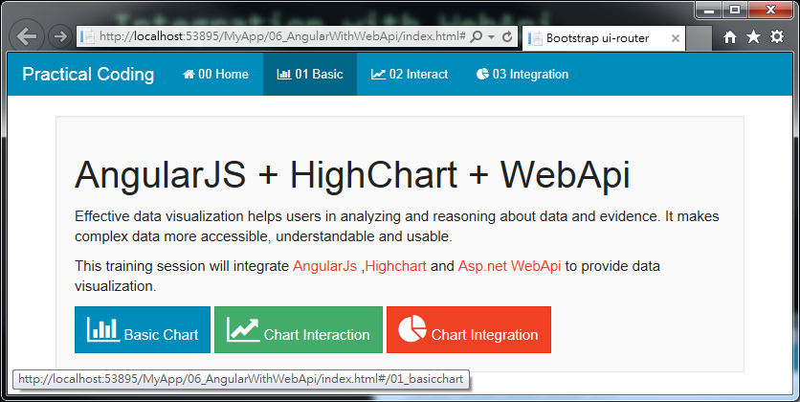
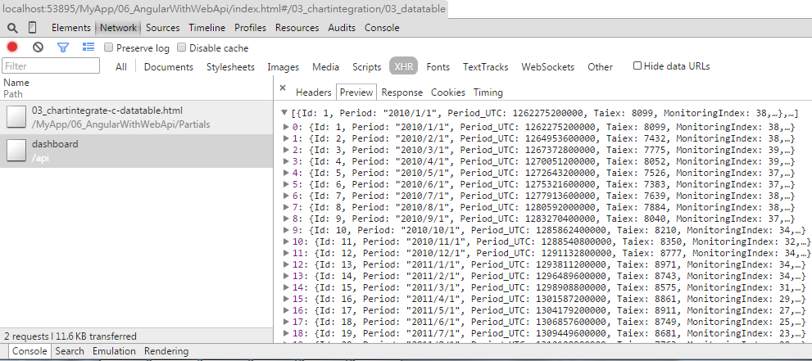
Integration with WebApi (Query)
Demo Page
Select “06_AngularWithWebApi” and Hit “F5” to run
Click “03 Integration→DATATABLE”
The result will show on a table also use Browser tools will show XHR result from WebApi

Slide 40
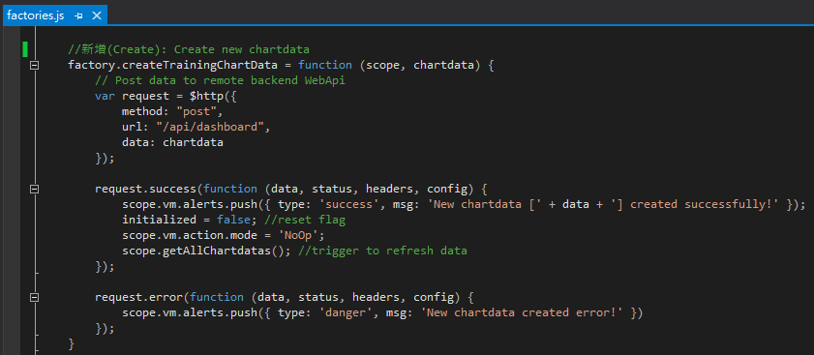
Integration with WebApi (factories.js) for Create
Add “factory.createTrainingData” method to POST data to remote WebApi “/api/dashboard” for creation operation
POST the data via remote WebApi using angular $http service object
If POST operation success, then execute this block
If POST operation error, then execute this block
Notes:
axes.

Slide 41
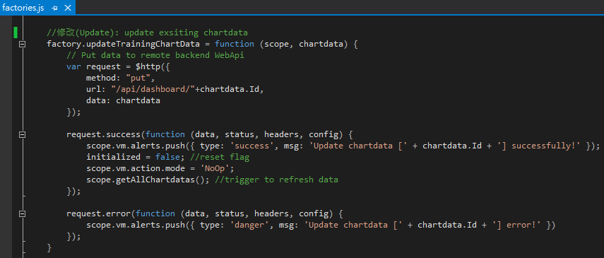
Integration with WebApi (factories.js) for Update
Add “factory.updateTrainingData” method to PUT data to remote WebApi “/api/dashboard/{id}”
PUT the data via remote WebApi using angular $http service object
If PUT operation success, then execute this block
If PUT operation error, then execute this block
Notes:
axes.

Slide 42
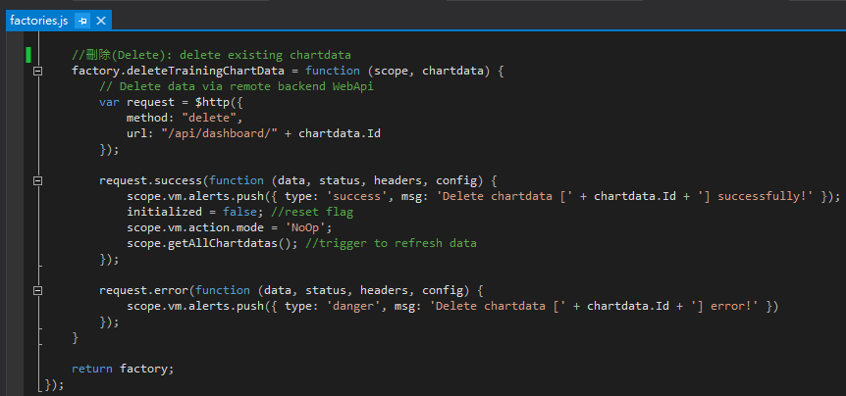
Integration with WebApi (factories.js) for Delete
Add “factory.deleteTrainingData” method to PUT data to remote WebApi “/api/dashboard/{id}”
DELETE the data via remote WebApi using angular $http service object
If DELETE operation success, then execute this block
If DELETE operation error, then execute this block
Notes:
axes.

Slide 43


Integration with WebApi (Create)
Demo Page
Select “06_AngularWithWebApi” and Hit “F5” to run
Click “03 Integration ➔ DATATABLE ➔ Create Form”
Input all necessary data and Hit “Create”

Slide 44


Integration with WebApi (Update)
Demo Page
Select “06_AngularWithWebApi” and Hit “F5” to run
Click “03 Integration ➔ DATATABLE ➔ Update Form”
Input all necessary data and Hit “Update”

Slide 45


Integration with WebApi (Delete)
Demo Page
Select “06_AngularWithWebApi” and Hit “F5” to run
Click “03 Integration ➔ DATATABLE ➔ Delete Form”
Input all necessary data and Hit “Delete”

Slide 46
Developing ASP.Net SignalR2

Slide 47


SignarR Web Resources
http://signalr.net
http://www.asp.net/signalr
Notes:
本章節的內容會延續前一個Session的知識與內容, 如果對前一章節不熟悉的話, 可以在Yoube或Slideshare找到文件與教學錄影

Slide 48

What is SignalR?
A library of adding real-time web functionality to Asp.Net applications
Real-time web functionality is the ability to have server code push content to connected clients instantly as it becomes available, rather than having the server wait for a client to request new data.

Slide 49

Environment Setup
Use NuGet to search “SignalR”
Click “Install”

Slide 50



Environment Setup
Add “OWIN Startup class” named “Startup.cs” under “ProjectCoding” webroot
Input “app.MapSignalR();” as show below

Slide 51




Simple SignalR Chat Application (JQUERY)
Create below files to build a simple SignalR Chat application

Slide 52


Simple SignalR Chat Application (JQUERY) – Server “ChatHub.cs”
Add new item -> “SignalR Hub Class(v2)” -> “ChatHub.cs”
A method which can used to broadcast a message to all SingnalR connected Clients

Slide 53


Simple SignalR Chat Application (JQUERY) – Client Html

Slide 54
Simple SignalR Chat Application (JQUERY)
Demo
Select “07_SignalRChat/01_SimpleChat_Jquery.html” and Hit “F5” to run
Open Multi-Browers to chat with each other

Slide 55



Simple SignalR Chat Application (AngularJs)
Create below files to build a simple SignalR Chat application using AngularJS

Slide 56

Create SignalR Hub class
Add new item -> “SignalR Hub Class(v2)” -> “ChatHub2.cs”
A method which can used to broadcast a message to all SingnalR connected Clients except message issuer
A simple POCO class as communication message object

Slide 57

AngularJs Module wrapped SignalR
https://github.com/JustMaier/angular-signalr-hub

Slide 58

Find Good Bootstrap UI Style Template
http://bootsnipp.com

Slide 59

02_SimpleChat_Angular.html

Slide 60

02_SimpleChat_Angular.html
Ask AngularJS to inject “chatHubFactory”
Ask AngularJS to inject “$rootScope”

Slide 61
Simple SignalR Chat Application (AngularJS)
Demo
Select “07_SignalRChat/02_SimpleChat_Angular.html” and Hit “F5” to run
Open Multi-Browers to chat with each other

Slide 62


Simple SignalR Chat Application (EventBus)
The drawback of previous Chat application sample
Tightly coupled – Client and Server Hub are very tight coupled, think about how many Server Hubs class we need to create for different scenarios?
Let’s refactoring previous SignalR Chat application using “EventBus” concept

Slide 63


Create SignalR Hub class
Add new item -> “SignalR Hub Class(v2)” -> “EventBusHub.cs”
Add new POCO class “SignalREvent.cs”
A simple POCO class as communication message object
A method which can used to broadcast a message to all SingnalR connected

Slide 64



Create Customise AngularJS “EventBus” module

Slide 65

UI AngularJS Code
Delegate message sending via “EventBusHub”
Only listen “Event” whatever this UI interesting

Slide 66


Simple SignalR Chat Application (EventBus)
Demo
Select “07_SignalRChat/02_SimpleChat_EventBus.html” and Hit “F5” to run
Open Multi-Browers to chat with each other

Slide 67
Highchart , AngularJS ,Web API2 + SignalR2 Integration

Slide 68

Integration with SignalR
Copy “06_AngularWithWebApi” to “08_AngularWithSignalR ”
Notes:
axes.

Slide 69


Integration with SignalR – **SignalRDashboardController.cs (WebApi)**
Copy “DashboardController.cs” to “SignalRDashboardController.cs”
Get SignalR “EventBus” Hub Context reference
Notes:
axes.

Slide 70


Integration with SignalR – **SignalRDashboardController.cs (WebApi)**
Whenever Create/Update/Delete operations occurred, a “SignalREvent” will be broadcast to all SignalR client via “EventBusHub”
Notes:
axes.

Slide 71

Integration with SignalR
Modify “index.html” to include “SignalR” related javascripts
Notes:
axes.

Slide 72

Integration with SignalR
Modify “app.js” to have AngularJS include “EventBus” module
Notes:
axes.

Slide 73


Integration with SignalR
Modify “factories.js -> 03_myapp_integrateDataTableCtrl” to listen SignalREvent published by “EventBus”
Inject “EventBusHub”
Notes:
axes.

Slide 74


Integration with SignalR
Modify “factories.js -> 03_myapp_integrateLineCtrl” to listen SignalREvent published by “EventBus” and refresh chart
Modify “factories.js -> 03_myapp_integrateDualAxesCtrl” to listen SignalREvent published by “EventBus” and refresh chart
Modify “factories.js -> 03_myapp_integrateMultiAxesCtrl” to listen SignalREvent published by “EventBus” and refresh chart
Modify “factories.js -> 03_myapp_integrateGauageCtrl” to listen SignalREvent published by “EventBus” and refresh chart
Notes:
axes.

Slide 75



Integration with SignalR
Demo
Select “08_AngularWithSignalR/index.html” and Hit “F5” to run
Open Multi-Browers to see charts reflect changes whenever C/U/D operations occurred

Slide 76


Next Session: AngularJS + Highchart + Asp.Net WebApi2 + SignalR2 + Entity Framework6

